Slide 1
Lunch and learn session
3D Printing by Erick Dominguez

Slide 2
What is 3D printing?
3D Printing is a process for making a physical object from a three-dimensional digital model
Notes:
Oscar

Slide 3
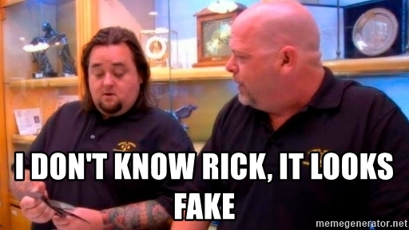
Notes:
Oscar

Slide 4
What do I need to print?
3D Printer
Plastic Hands (Optional)
Notes:
Oscar

Slide 5
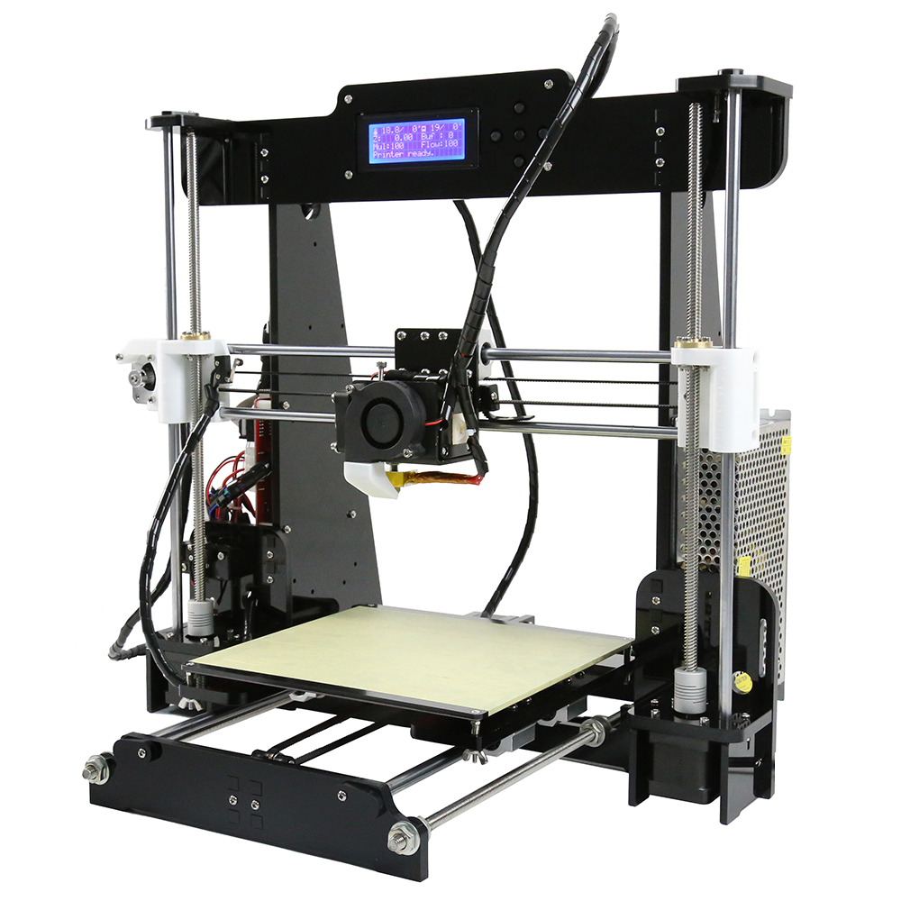
The 3D Printer
Notes:
Oscar

Slide 6
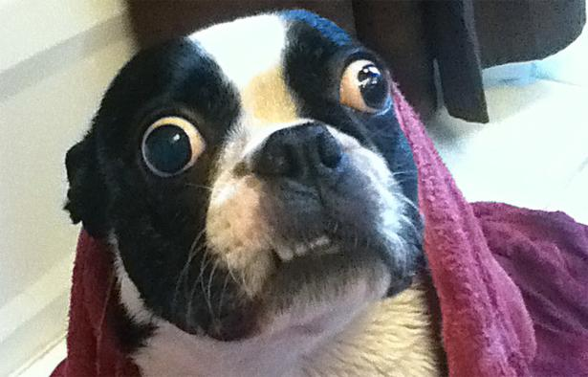
How does a 3D printer works?
Notes:
Oscar

Slide 7
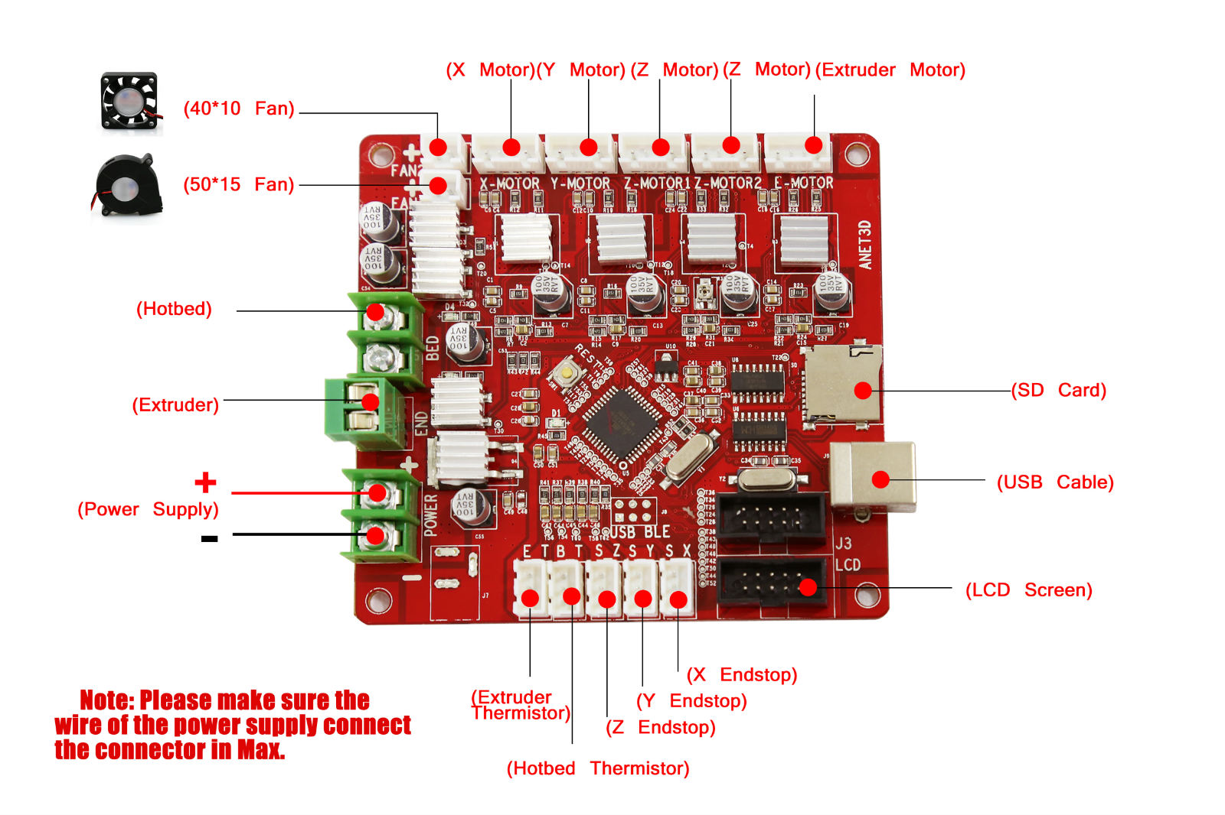
The Controller board
Notes:
Oscar

Slide 8
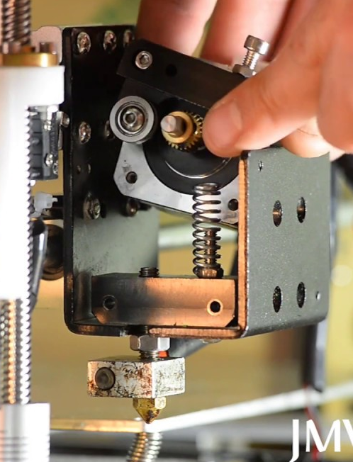
The Extruder
Fat Finger
Extruder Motor
Heat Sink
Nozzle
Notes:
Oscar

Slide 9
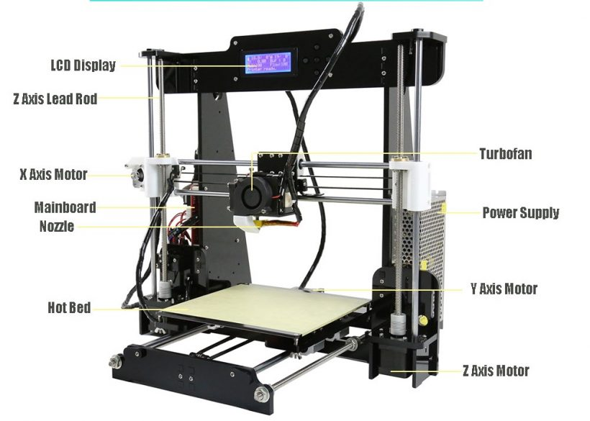
General View
Notes:
Oscar

Slide 10
What can I get from a 3d Printer?
All you can design
Notes:
Oscar

Slide 11

How can I start?
With a model!
Notes:
Oscar

Slide 12
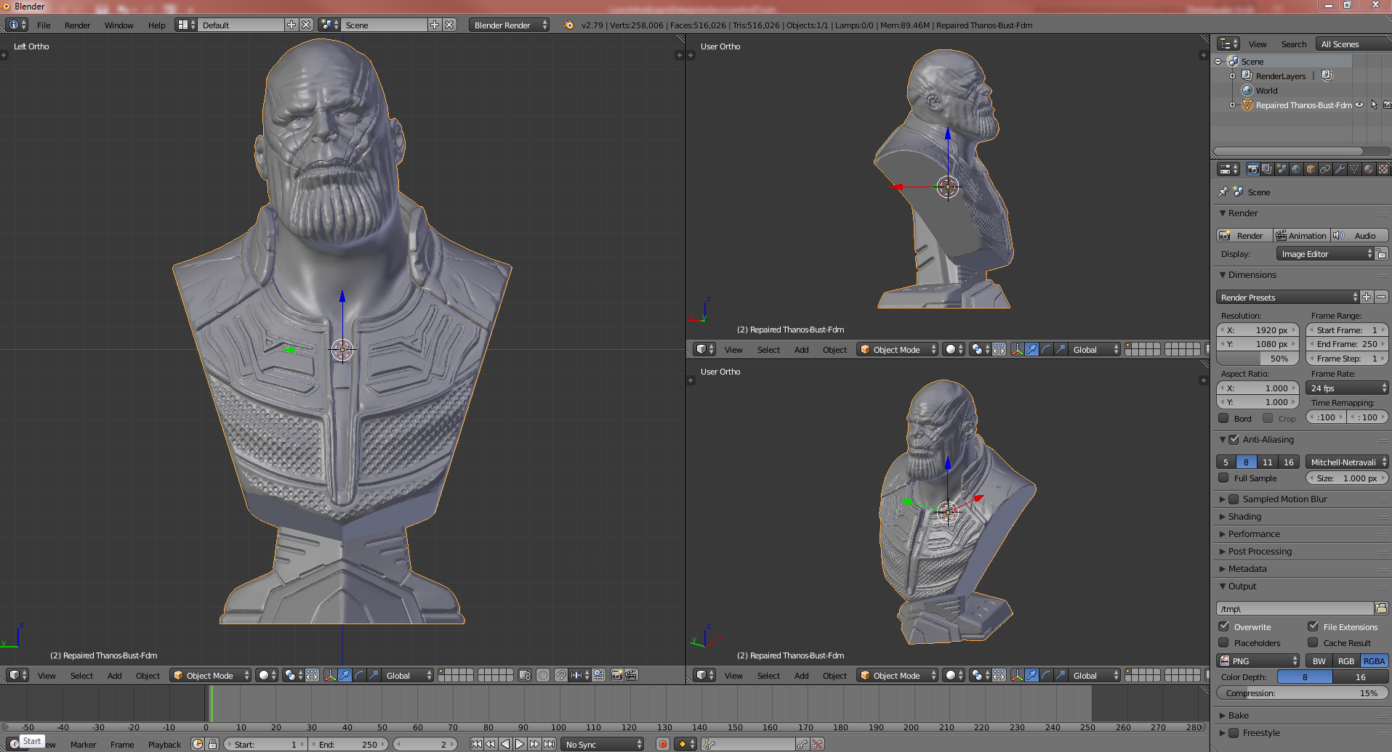
Modeling
Notes:
Oscar

Slide 13
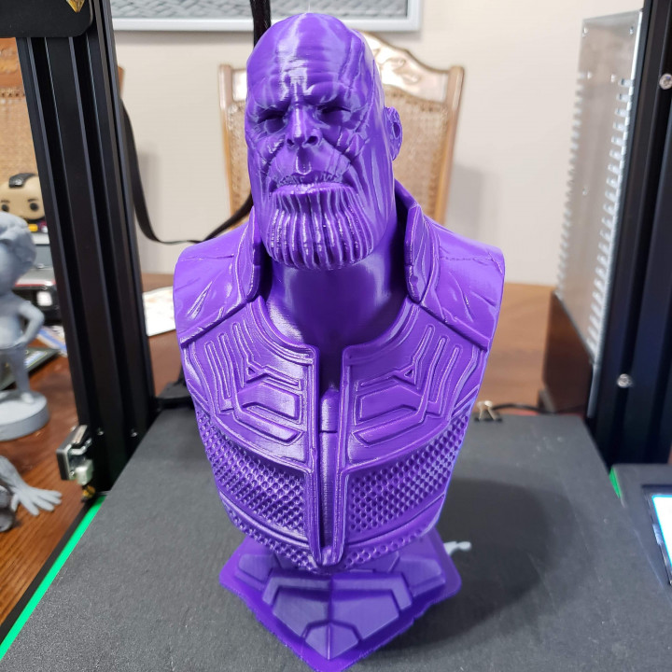
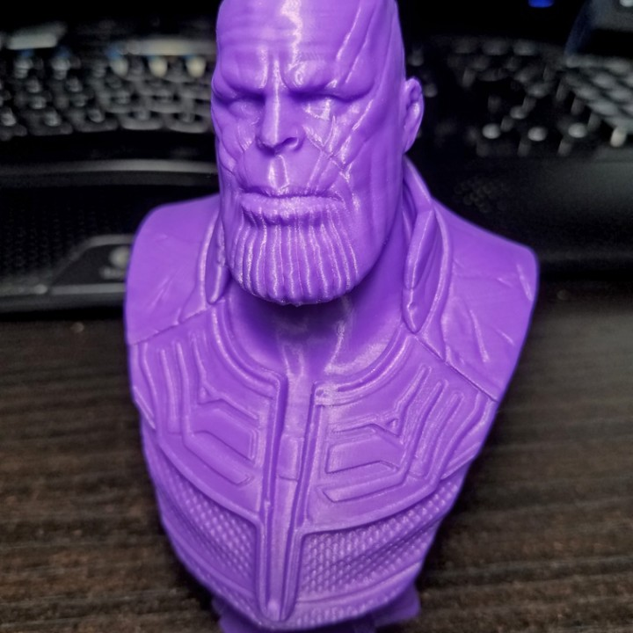
3d Printing

Slide 14
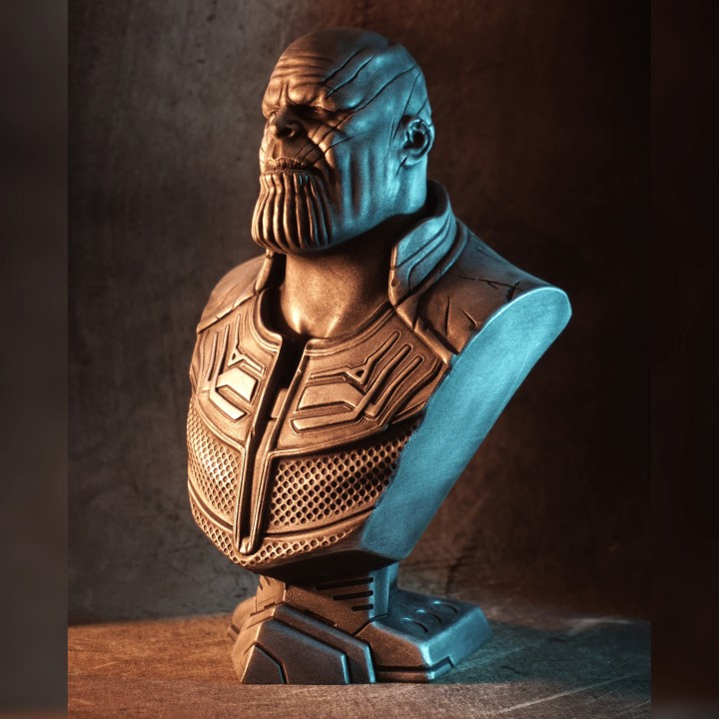
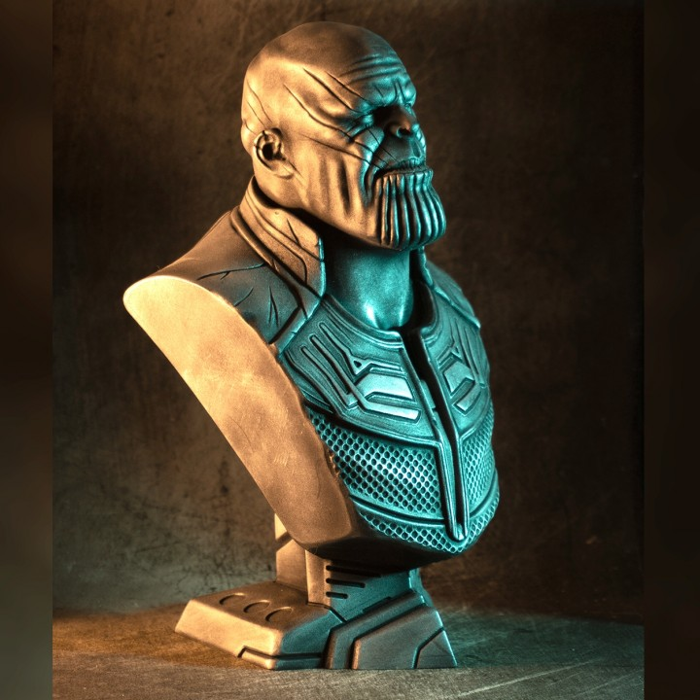
Post Processing

Slide 15
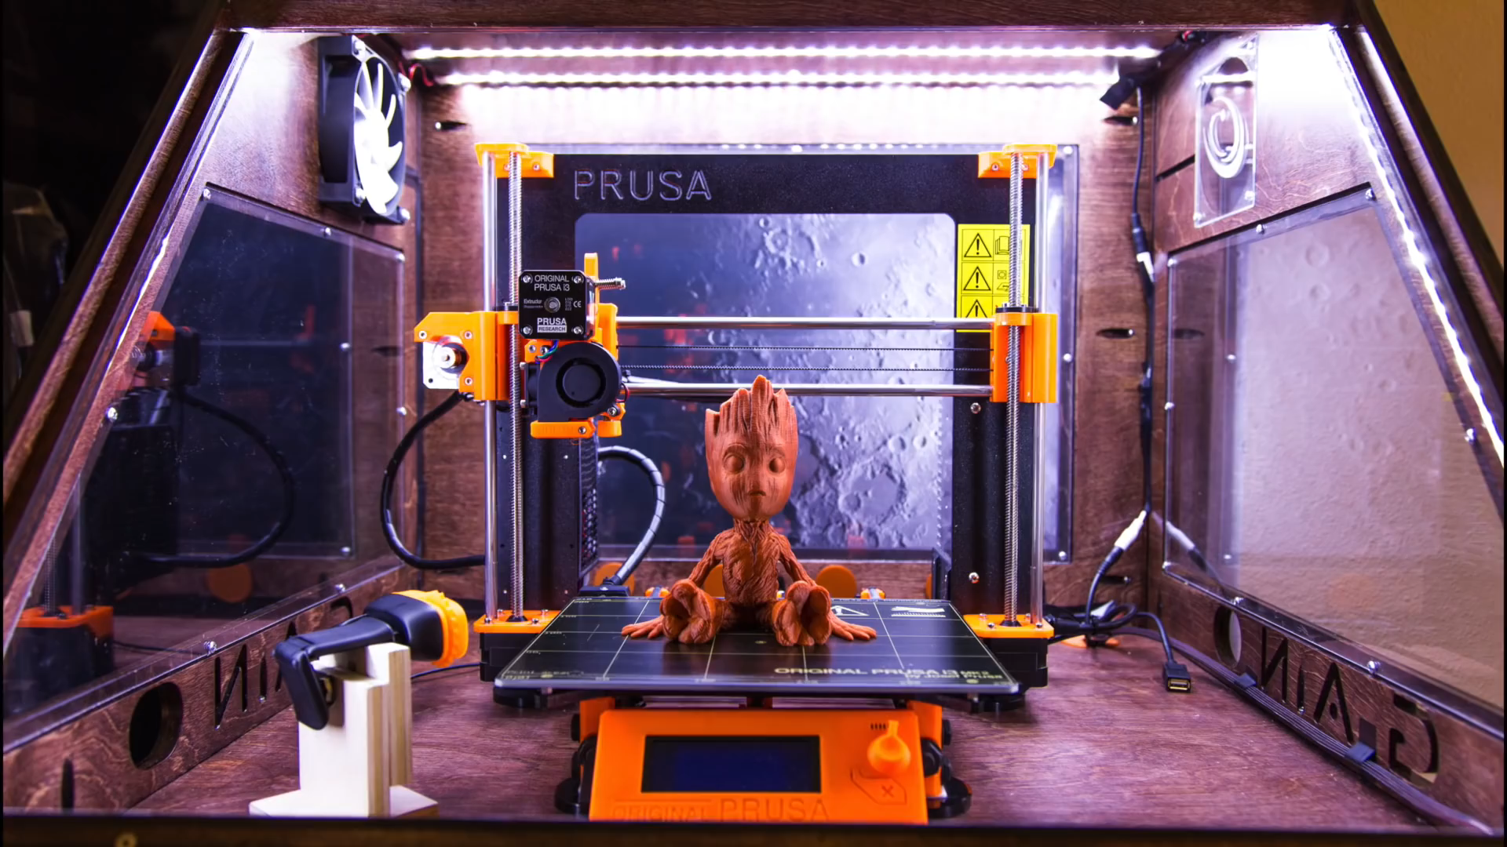

Slide 16
Do I need to have modeling Skills?
No, well… sometimes.
Notes:
Oscar

Slide 17

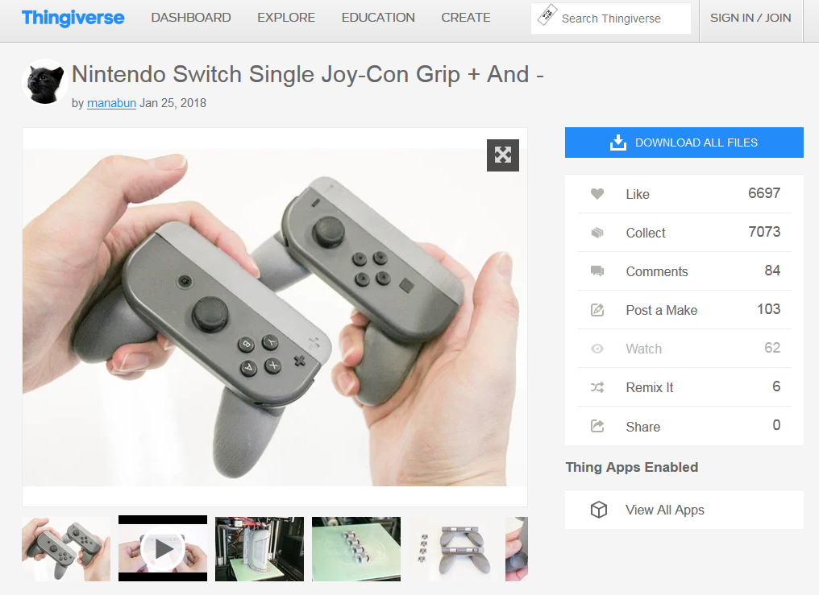

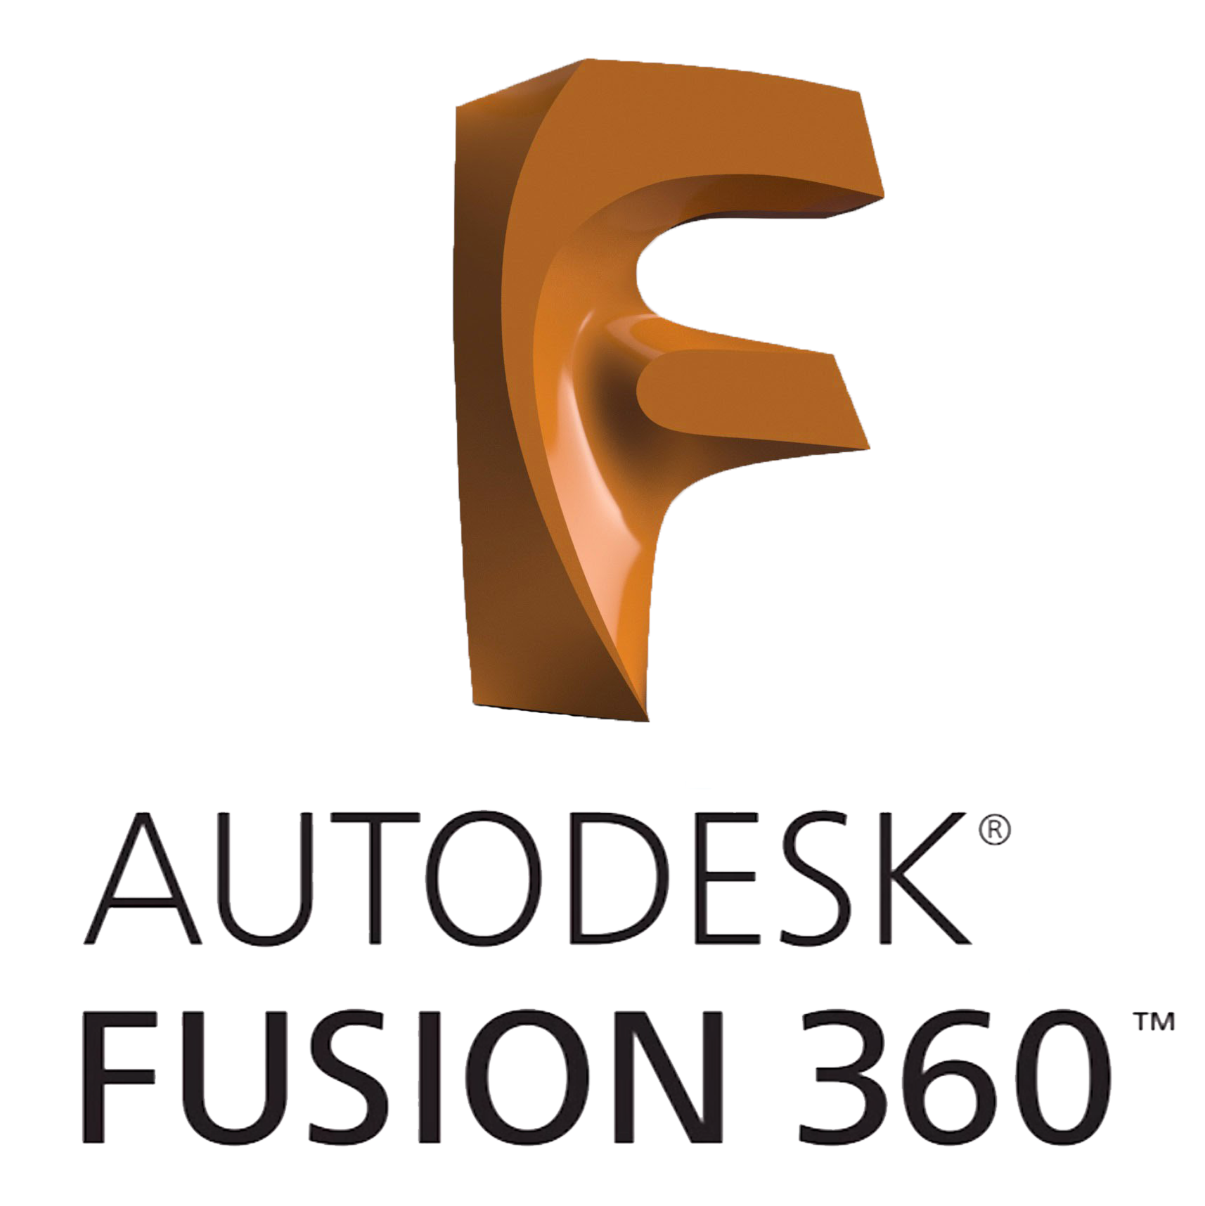
Options to obtain 3d models
DIY
Ready to Print
Notes:
Oscar

Slide 18
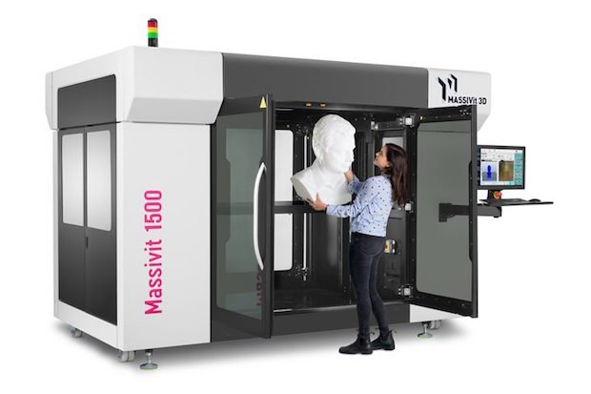
Size Matters
The bigger your 3D printer is the bigger your prints will be
Notes:
Oscar

Slide 20
QA
Enterprise Services and Tools

Slide 21
Thanks!

